Slide 1
What is a PBM?
We generally think of the Pharmacy Benefit Managers (PBMs) as:
Entities that administer the prescription drug portion of a health plan
Middlemen between health plans/consumers and drug companies
The entity that negotiates drug prices and creates drug formularies
Three PBMs control close to 80% of the group health plan (GHP) market: (1) Express Scripts (Cigna business), (2) CVS/Caremark and (3) OptumRx (business of UnitedHealth Group)

Slide 2
Understanding a PBM Contract
The parties:
PBM,
Pharmacy,
Employer,
Group Health Plan (GHP),
Pharmaceutical Company, and
Wholesaler
For ERISA-covered plans, the main players are the employer, the group health plan and the PBM

Slide 3
The Main Players
For an employer-sponsored GHP, the employer (or plan) contracts with a PBM for it to manage and administer the prescription drug portion of the plan
The PBM receives fees for providing services such as creating a network of pharmacies and administering claims and appeals
Separately, a PBM enters into contracts with pharmacies that dispense the drugs, and those contracts address the amount the pharmacies will be paid for the drugs dispensed to the GHP participants

Slide 4
The Main Players
The pharmacies negotiate upstream in the supply chain through agreements with wholesalers. Wholesalers supply and set the wholesale rates at which pharmacies obtain the drugs they dispense
The wholesalers themselves negotiate to buy the drugs from the manufacturers
Once the drugs are in the pharmacies, these drugs are subsequently distributed to consumers, such as GHP participants
Participants often pay a co-pay or coinsurance amount
With the rise of HDHPs, participants in HDHPs pay the “full cost” until the deductible is met

Slide 5
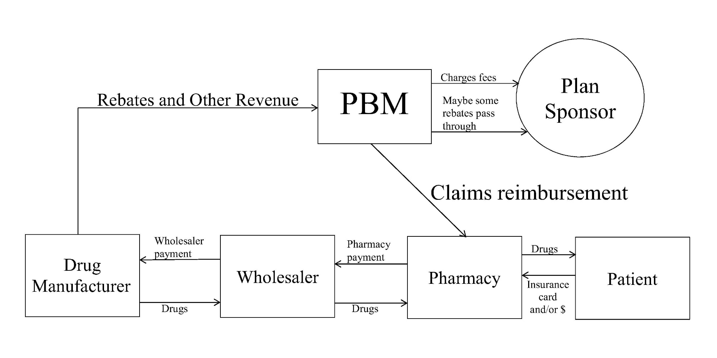
CHART

Slide 6
Where the Money is Made
There are numerous ways the PBMs make money, such as:
Spread Compensation
Formulary Fees
Market Share Fees
Drug Reclassification
Multiple MAC lists
Rebates

Slide 7
Where the Money is Made
One source is through “spread compensation”
A PBM contracts with a GHP to obtain drug prices for some percentage off AWP
AWP is the average wholesale price
AWP bears no connection to the actual price any entity will pay for those drugs. It is a “sticker” price that is set very high
The PBM has a separate contract with the pharmacy networks to reimburse based on a percentage of AWP (or some other formula) that differs from the discount offered to employer-sponsors

Slide 8
Spread Compensation—$$$$
EXAMPLE:
PBM has a contract with a pharmacy chain to reimburse the pharmacy for a drug that it dispenses at the price of $300, but the PBM separately charges the GHP $1,000
The $700 differential is referred to as the “spread compensation” which the PBM retains as profits from the transaction
The spread can be A LOT of money
The amount of this spread compensation is NOT DISCLOSED to the employer-sponsor of the GHP

Slide 9
Rebates
PBMs receive rebates from drug manufacturers for the placement of their drugs on a formulary
A rebate is a discount on a medication a drug manufacturer gives a PBM in return for the PBM agreeing to place the drug on a formulary
Some experts believe that on average, a third of the net price paid for medications is attributable to those rebates—meaning the cost to the patient may be 1/3rd higher due to rebates (IMS Institute for Healthcare Informatics)
The current system incentivizes companies to push the list prices higher (such as the AWP), only to rebate money later, on the back end. (FDA Commissioner, Senate Hearing, 2016)

Slide 10
Brand and Generic
These are key terms—pricing and guarantees are based on these terms
These terms need to be locked down. Example of a current definition in a contract:
“Generic drug: The term “generic drug” shall mean a multisource drug set forth in a nationally recognized source, as reasonably determined by the PBM, that is available in sufficient supply from multiple FDA-approved generic manufacturers of such drugs.”

Slide 11
Brand and Generic
What does that mean?
Can you audit against this definition?
Under the above definition, the PBM is likely to categorize all single-source generics as brands
We suggest that the definition of generic state what reporting service is being used (such as MediSpan) and the exact codes used for determining which drugs are generics
MediSpan and First Databank do not use the same codes
Push to have a provision in the contract that states that once a drug is categorized, it stays in that category—a consistency provision

Slide 12
Brand and Generic
Some PBM contracts allow the PBM to classify drugs for one purpose in one way, and for another purpose in another way
When it is in the PBM’s interest to classify more drugs as brands — for instance, when determining how to invoice clients — the PBM uses its ambiguous and discretionary definitions to shift drugs into the brand category
When the PBM wants to make its generic substitution rate appear greater, it may reclassify drugs that were invoiced as brands to be re-characterized as generics
If a contract requires the PBM to pay a specified rebate for brand drugs, it could reclassify drugs that were invoiced as brands to be re-characterized as generics for the purpose of calculating rebates

